Slide 1
Distributed Computing

Slide 2
Housekeeping
You should get homeworks back soon
Today’s lecture should be much more prepared
If you missed me at office hours email me today
Quiz next week on this

Slide 3
Key points of discussion of Facebook et. al.
Nuanced data that Facebook and Google have can be and has been weaponized via machine learning (and related) techniques
Giving a company access to that level (not just cookies or other smaller things) is a serious deal and regulation is important
Using open source and cryptographically secure methods of communication is the only way to prevent this
Without these, we’re moving to a point without any reasonable level of freedom of information or speech
Signal is the best example of this, and recently has become usable to the average person
Machine learning isn’t perfect, and algorithms intrinsically reflect our biases
Making critical or mass decisions based on them should not be taken lightly

Slide 4
Alternate title:
What happens when all my data or processing can’t fit on one ____?

Slide 5
CPU Cores
Single core performance
Moore’s Law
Limitations
Point of FPGAs, GPUs
When things are faster on CPUs (including tiny neural nets)
Power considerations

Slide 6
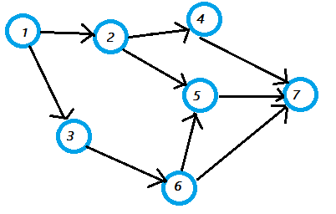
Directed Acyclic Graphs, Sparsity
Conditions for sparsity/density
Limits on parallelization
“Split-Apply-Combine”
MapReduce
Three main classes
Apply to both CPU and GPU

Slide 7
Examples
Cluster
Rendering frames for a 3D movie
Cryptocurrency Mining
Factoring prime numbers
Multicore
Encoding video
Rendering 3D frames
Training or inferencing for neural nets, most ML algorithms
FFTs
Single core
I/O response time (mouse, keyboard, other external queries)
CPython, Ruby MRI, etc.
Old school AI (common in games)
Lots of Physics
GPU Caveat (AlphaGo example)

Slide 8
A simplified diagram of a modern websites server architecture
Web Request
DNS
Load Balancer
Web Servers (Python, Ruby, Java, etc)
Database
Other services

Slide 9
Terminology
Parallel computing
Mainframe
Supercomputer
Cluster
Server (cloud)
Distributed computing

Slide 10
Handful of Notes
Stream/Batch processing
DBs/storage distribution
Google BigQuery is amazing
Role of (and considerations regarding) interpreted languages

Slide 11
Distributed Computing Tools
Apache Spark, Hadoop, Kafka, Storm
Dask, Airflow
Easily 100 other meaningful ones
Most maintained by the Apache foundation

Slide 12
LSTM (Long Short-Term Memory) Layers

Slide 13

A clarification with RNNs
Struggles at important variables being far apart
I.e. much of the past information after seeing a frame in a video
Vanishing gradient problems
LSTMs solve this

Slide 14
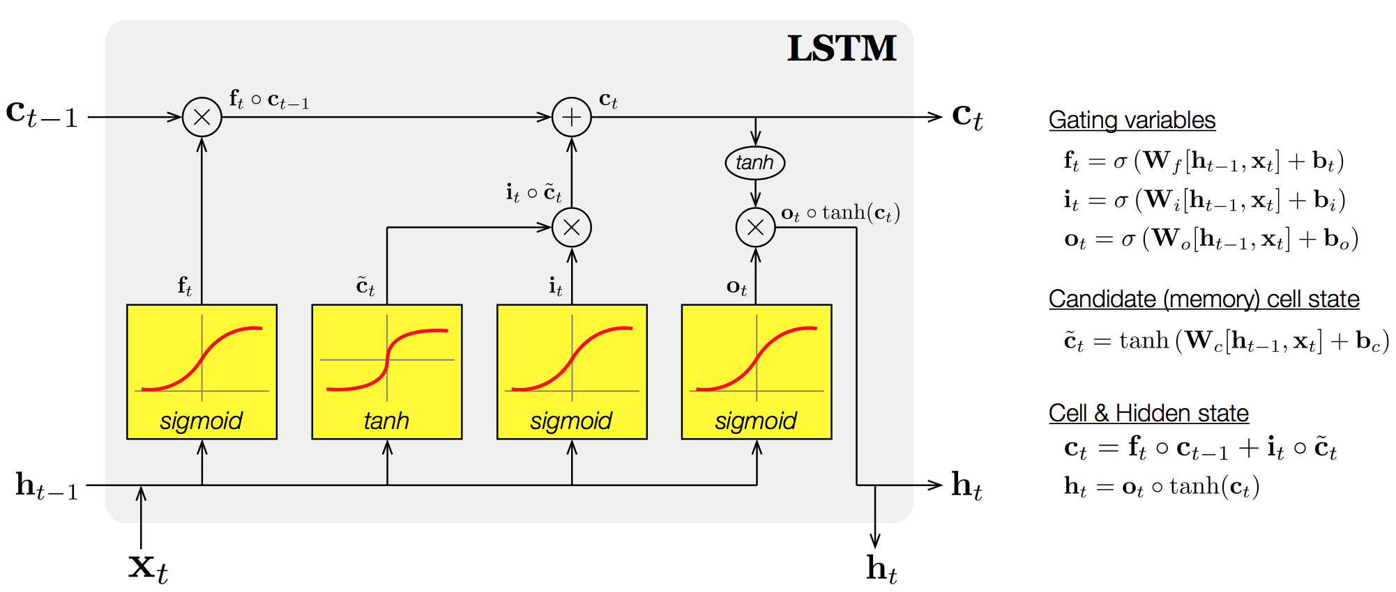
LSTM

Slide 15
LSTM Links
https://github.com/aymericdamien/TensorFlow-Examples/blob/master/notebooks/3_NeuralNetworks/dynamic_rnn.ipynb
http://colah.github.io/posts/2015-08-Understanding-LSTMs/
https://github.com/llSourcell/LSTM_Networks/blob/master/LSTM%20Demo.ipynb

